Slide 1
CE/CZ4045
Natural Language Processing
Group 31

Slide 2




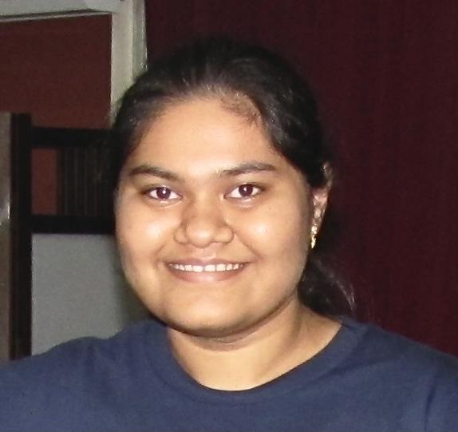
Introduction - Group Members
Akshat
Angelin
Divyansh
Suhana
Aishwarya

Slide 3
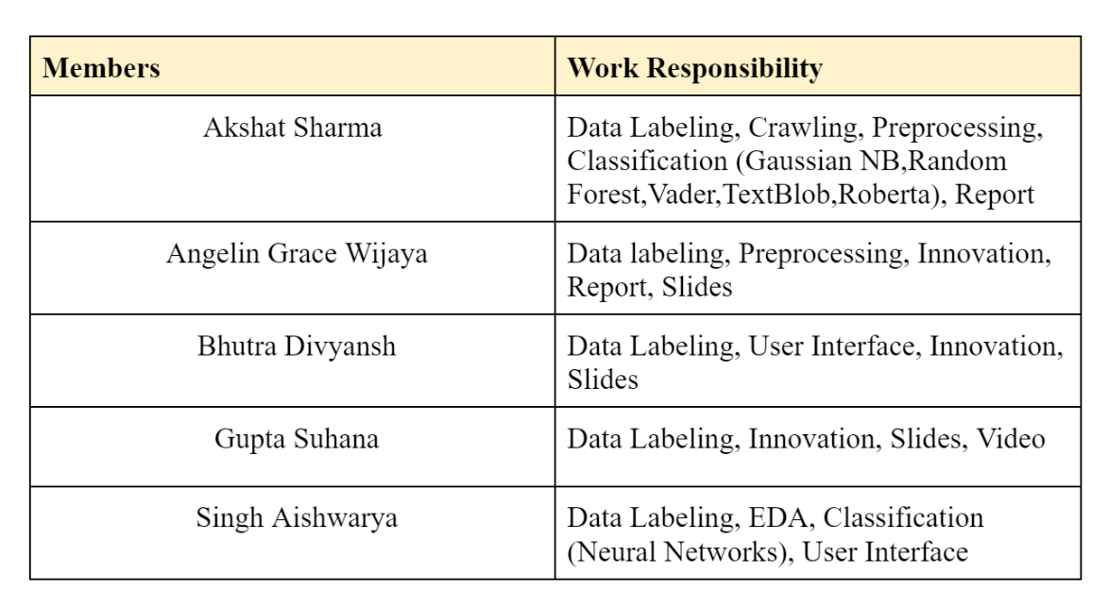
Introduction - Members Role

Slide 4

Introduction - Domain
Football has an estimate of 3.5 billion fans worldwide
Matches and players get millions of social mentions every day on Twitter
Manchester United hashtag #mufc alone gets around 1 million mentions per week
6 Teams of English Premier League:
Arsenal
Manchester United
Manchester City
Tottenham Hotspurs
Liverpool
Chelsea
Sentiment Analysis could help understand:
What majority of fanbase think about their team before and after a match?
How does the sentiments change over some time? Does it affect the team’s performance?
How does the fanbase welcome decisions made by the team? Could there be toxicity within the fanbase?

Slide 5
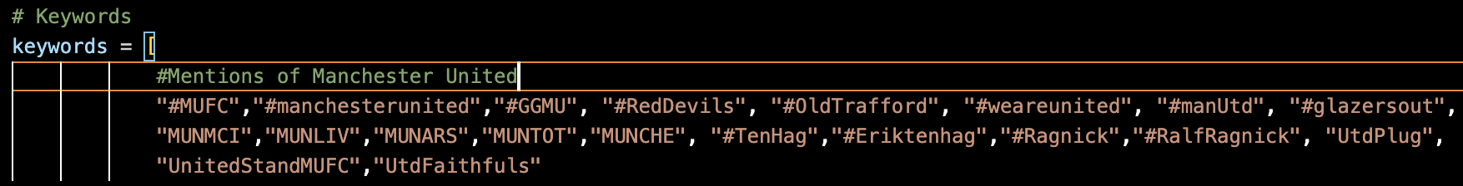
Introduction - Crawling
Function used: TwitterSearchScraper from the snscrape.modules.twitter
Time frame: 2021-08-01 until 2022-09-04
Maximum tweets per hashtag: 500

Slide 6
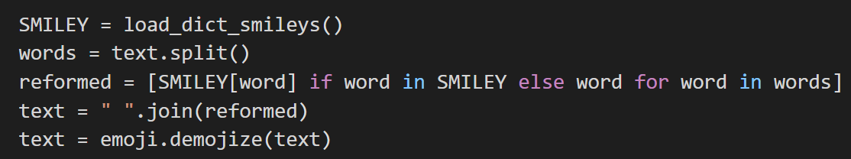
Preprocessing - Steps
Removal of irrelevant tweets containing certain keywords
Lowering of the text
Removal of hashtags, links and twitter handles
Conversion of emojis and emoticons
Removal of accented characters
Expansion of contractions
Removal of special characters
Tokenization
Lemmatization
Spelling Correction

Slide 7
Classification Models & Algorithms
Gaussian Naive Bayes & Random Forest

Slide 8
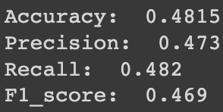
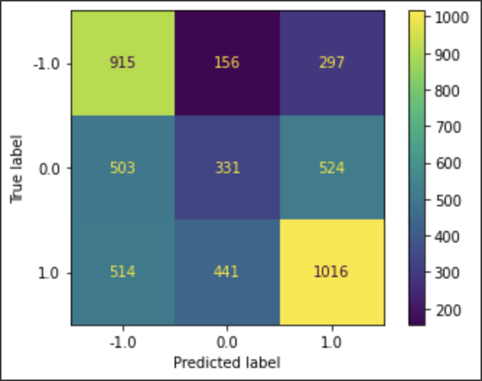
Gaussian Naive Bayes
Classifier separates data into different classes according to Bayes’ Theorem with the assumption that the predictors are independent of each other.
tf-idf vectors have been constructed - the features have a continuous value
Performs as a poor estimator - It is also observed that when spelling correction was applied to Naive Bayes, the accuracy decreased slightly.

Slide 9
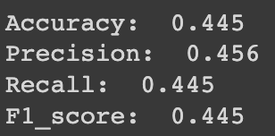
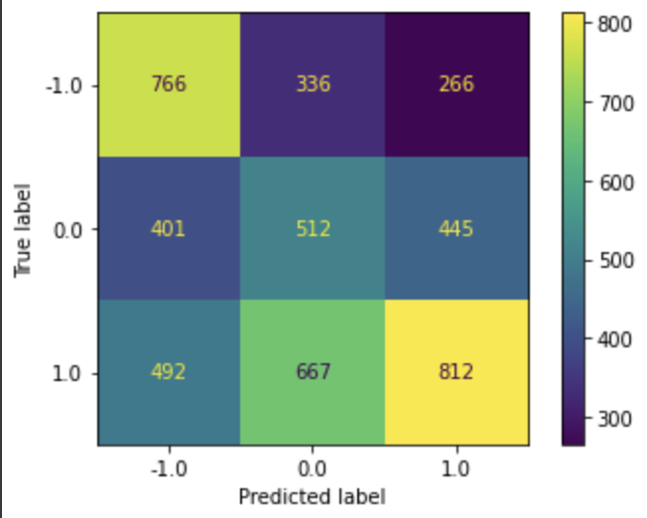
Random Forest
An ensemble of decision tree classifiers - Feature randomness and bagging are used to create an uncorrelated forest of trees. Thus, we have trees that are trained on not only different sets of data but also use different features to make decisions.
If the data contains groups of correlated features of similar relevance to output, smaller groups are favored over larger ones
Poor performance despite hyperparameter tuning.

Slide 10
Classification Models & Algorithms
Lexicon-based Sentiment Analysis

Slide 11
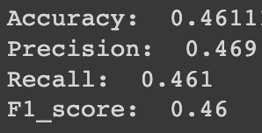
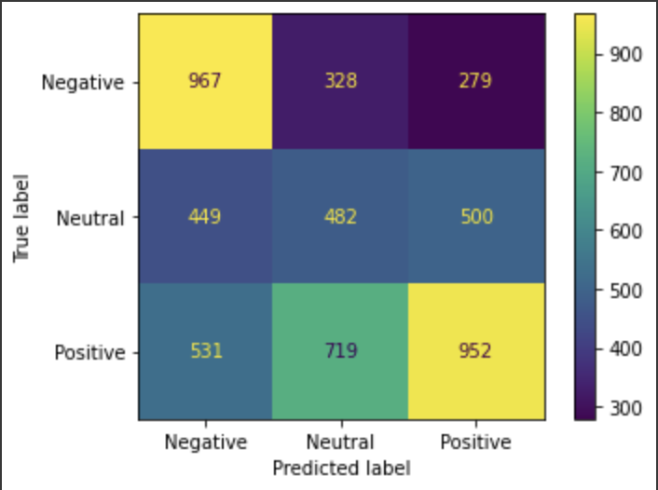
VADER (Valence Aware Dictionary for Sentiment Reasoning)
Lexicon and rule-based feeling analysis instrument
Words in the vocabulary are appraised with respect to whether they are positive or negative
Poor performance due to the lexicon not being updated frequently and missing major slangs used in tweets currently to communicate opinions

Slide 12
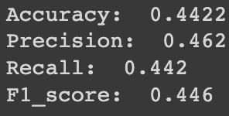
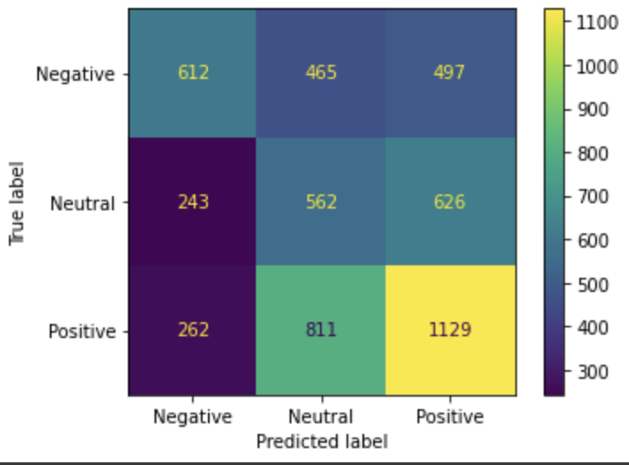
TextBlob
Python NLP library that uses the database of Natural Language Toolkit’s (NLTK) WordNet
Textblob is applicable for complex analysis and working with textual data. When a sentence is passed into Textblob, it gives two outputs which are polarity and subjectivity.
Performed Subjectivity and Polarity detection using TextBlob library for each tweet

Slide 13
Classification Models & Algorithms
Deep Learning Models

Slide 14
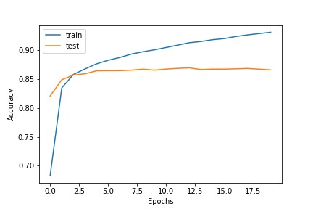
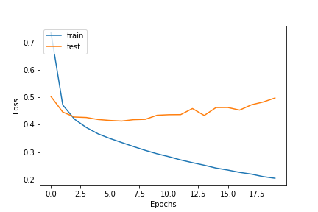
Neural Networks
Bidirectional-Long Short-Term Memory NN with an Attention layer - capable of handling long-term dependencies and improves the problem of vanishing gradients.
Bidirectional LSTM (Bi-LSTM) enables neural networks to have both backward and forward information about the sequence at each time step.
Hyperparameter tuning performed on all layer parameters - GridSearchCV.
Deceptively high categorical accuracy - overfits on the data

Slide 15
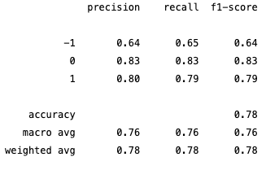
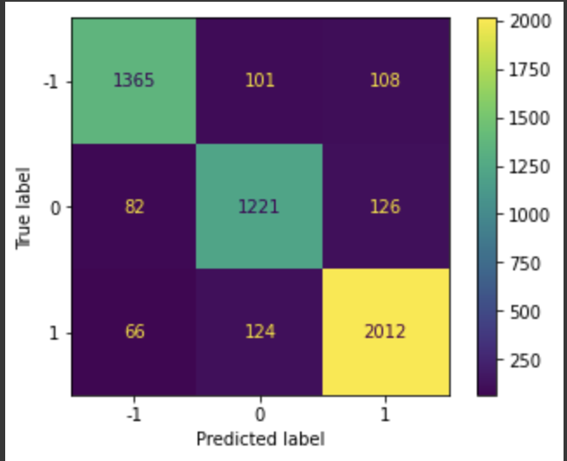
RoBERTa Embeddings & Model (with Enhancements)
RoBERTa is a retraining of the BERT model with improved training methodology.The key innovation of the BERT model was the application of bidirectional training of Transformer architectures to language models.
BERT also incorporates methodologies like attention mechanism, Masked language modelling and Next Sentence Prediction.
During implementation, added a FeedForward layer followed by a fully connected layer after the RoBERTa transformer output for classification.
Best performance compared to all other models

Slide 16
Innovations

Slide 17
User Interface

Slide 18
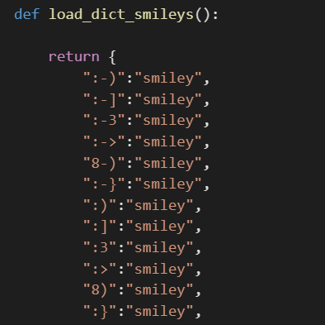
Preprocessing Innovation
Emoji’s are essential in understanding the sentiment of a tweet, therefore we created a dictionary to convert emoticons into a word that describes them.
After trial and error we realised that spelling correction may change a correct word into an unintended one, such as changing ‘Cristiano’ to ‘Christian.’ Therefore, we decided not to perform spelling correction during preprocessing

Slide 19
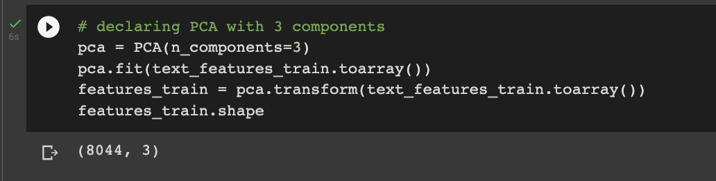
Principal Component Analysis (PCA)
PCA, is a statistical procedure that allows you to summarize the information content in large data tables by means of a smaller set of “summary indices” that can be more easily visualized and analyzed.

Slide 20
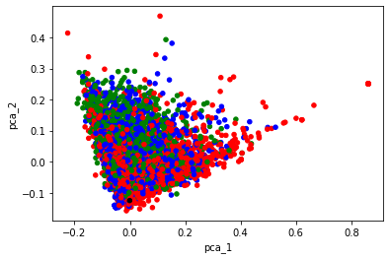
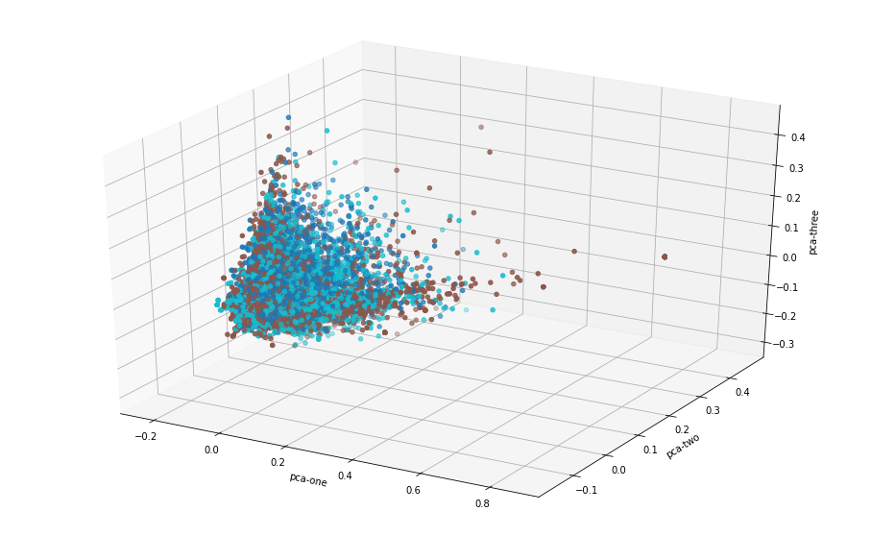
Our Observations:
The PCA plots highlight the similarity in the clusters of samples.
Due to the higher sample size of the neutral class, the model may assign a higher percentage of tweets as neutral, as similar words may be used in the positive and negative class.
On the right are the 2D and 3D visualizations.

Slide 21
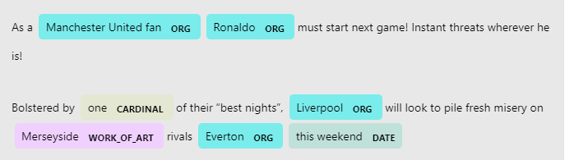
Named Entity Recognition (NER)
NER is the process of identifying important word(s) and categorizing them.
NER can categorize into categories based on POS and other context as well.
We used SpaCy, which is a pre-trained NER model. Here’s an example:

Slide 22
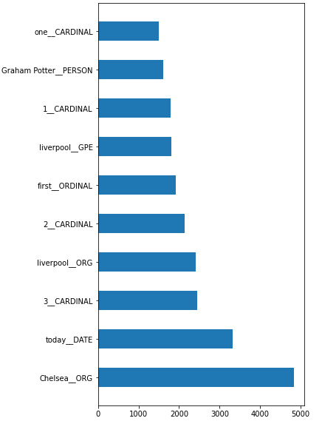
We tallied the most commonly occurring named entities and graphed them.
The model is quite inaccurate, labeling Liverpool as both an organisation (correct) and a geo-political entity (incorrect)
Since the classification accuracy of NER is quite low, we ultimately decided to not use this model.

Slide 23
Conclusion
Thank you!

